Slide 1
System Analysis and Design
Unit 3: Analysis

Slide 2
Structuring System Process Requirements
Structured analysis is a set of techniques and graphical tools that allow the analyst to develop a new kind of system specification that are easily understandable to the user.
i.e a set of techniques that allow the analyst to design the proposed system
The traditional approach focuses on the cost benefits and feasibility analysis, project management, hardware and software selection and personal consideration.
In contrast, structured analysis considers new goals and structured tools for analysis.
Structured analysis is a development method for analysis of an existing system.
The main purpose of structured analysis is to completely understand the current system.

Slide 3
The new goals specify the following:
Use graphics wherever possible to help communicate pattern with the user.
Differentiate between logical and physical system.
Build a logical system model to familiarize the user with system characteristic and interrelationship before implementation.

Slide 4
The structured tools:
Process Modeling
a. Dataflow Diagrams
2. Logical Modeling
a. Decision Tables
b. Decision Trees
c. Structured English
3. Conceptual Data Modeling
a. ER diagrams
4. Data Dictionary

Slide 5
Process Modeling
A technique for graphically representing the functions, or processes, that capture, manipulate, store, and distribute data
between a system and its environment
and between components within a system.
A common form of a process model is a data flow diagram (DFD).

Slide 6
Data Flow Diagram (DFD)
are widely used graphic tools for describing the movement of data within or outside the system.
i.e. shows pictorial movement of data (flow of data) between external entities, processes and data store within a system
a common technique for creating process models.
shows how data moves through an information system but does not show program logic or processing steps.
consists of a series of bubbles joined by lines, it is also known as a ‘bubble chart’.
also called transformation graph, or process model.

Slide 7
Four symbols are used to represent DFDs:
data flows,
data stores,
processes, and
sources/sinks (or external entities)
Two different standard sets can be used as proposed by:
DeMarco and Yourdan
Gane and Sarson

Slide 8
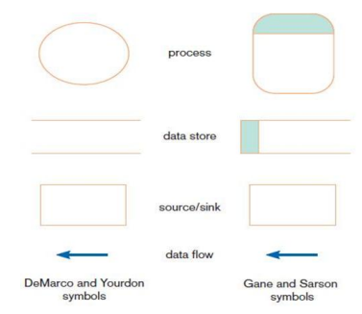

Slide 9
a. Process:
is work or actions performed on data
so that they are transformed, stored, or distributed.
Receives input data and produces output with different content and forms
symbol – oval or rectangle with rounded corners.
Inside the oval or rectangle are written both the number of the process and a name, which indicates what the process does.
Eg, apply payment
calculate commission
verify order
Food Ordering system
1

Slide 10
b. Data Store
is data at rest.
may represent one of many different physical locations for data, including
a file folder,
one or more computer-based file(s),
or a notebook.
Symbol - rectangle with the right vertical line missing.
Its label includes the number of the data store (e.g., D1 or D2)
and a meaningful label, such as student file, transcripts, or roster of classes.
D1
Goods sold file

Slide 11
c. Source/Sink (External Entities)
is the origin and/or destination of the data (outside of the system).
are sometimes referred to as external entities because they are outside the system and define the system’s boundaries.
Data must originate outside a system from one or more sources,
and the system must produce information to one or more sinks.
symbol - square.
name states what the external agent is.
Eg, person, organization, department
Customer

Slide 12
d. Data Flow
is data that are in motion and moving as a unit from one place in a system to another.
Symbol - arrow.
The arrow is labeled with a meaningful name for the data in motion
Eg, customer order, sales receipt, or paycheck.
Purchase Order

Slide 13
DFD is used for:
Logical information flow of system
Determination of physical system construction requirement
Simplicity of notation
Establishment of manual and automated system requirement
Visual representation makes a good communication tool between user and system designer

Slide 14
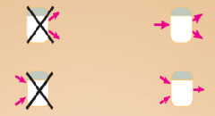
DFD Diagramming Rules:
Rules for Process:
No process can have only outputs. (miracle)
If an object has only outputs, then it must be a source.
2. No process can have only inputs (black hole).
If an object has only inputs, then it must be a sink.

Slide 15
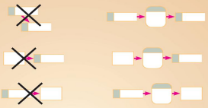
Rules for Data Store
1. Data cannot move directly from one data store to another data store.
Data must be moved by a process.
2. Data cannot move directly from an outside source to a data store.
Data must be moved by a process that receives data from the source and places the data into the data store.
3. Data cannot move directly to an outside sink from a data store.
Data must be moved by a process.

Slide 16

Rules for Source/Sink (External Entities):
1. Data cannot move directly from a source to a sink.
They must be moved by a process if the data are of any concern to our system.
Otherwise, the data flow is not shown on the DFD.

Slide 17
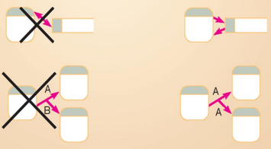
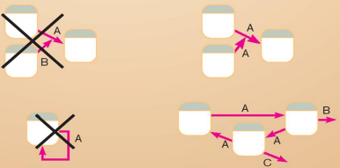
Rules for Data Flow
A data flow has only one direction of flow between symbols.
2. A fork in a data flow means that exactly the same data going to different locations(processes, data stores, or sources/sinks)
3. A join in a data flow means that exactly the same data come from different processes, data stores, or sources/sinks to a common location.
4. A data flow cannot go directly back to the same process it leaves.
At least one other process must handle the data flow, produce some other data flow, and return the original data flow to the beginning process.
5. A data flow to a data store means update (delete or change).
6. A data flow from a data store means retrieve or use.

Slide 18
DFD Levels
1. Context Diagram/ Level 0 DFD
Overview of the organizational system
Contains only one process
shows the system boundaries, external entities that interact with the system, and major information flows between entities and the system
For example, Grading System, Order Processing System, Registration System.
The context level diagram gets the number 0 (level zero).

Slide 19
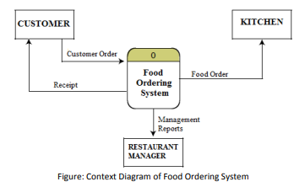
Figure: Context Diagram/ Level 0 of Food Ordering System
Note: Only one process symbol and no data stores are shown in context diagram.

Slide 20
2. Level-1 DFD
shows system’s major processes, data flows, and data stores at a high level of abstraction.
Processes are labeled 1.0, 2.0, 3.0etc

Slide 21
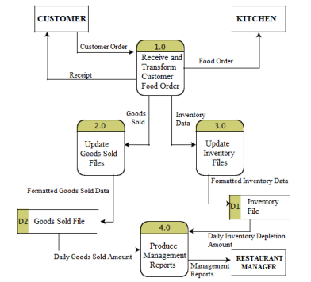
Figure: Level-1 DFD of Food Ordering System

Slide 22
3. Level-2 DFD
shows the sub-processes of one of the processes in the Level-1 DFD.
Results from decomposition of Level 1 diagram
Processes are labeled 1.1, 1.2. …, 2.1, 2.2. ….4.1, 4.2. …., etc

Slide 23
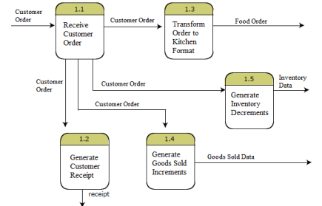
Fig: Level-2 DFD Showing Decomposition of Process 1.0 from the Level-1 Diagram

Slide 24
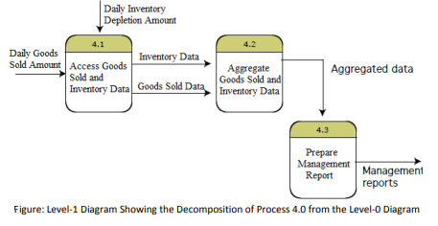
Fig: Level-2 DFD Showing Decomposition of Process 4.0 from the Level-1 Diagram

Slide 25

4. Level-n DFD
shows the sub-processes of one of the processes in the Level n-1 DFD.
Results from decomposition of Level n-1 diagram
Processes are labeled 4.3.1, 4.3.2, etc
Fig: Level-3 DFD Showing the Decomposition of Process 4.3 from the Level-2 Diagram for Process 4.

Slide 26
Logical DFD vs. Physical DFD
A Logical DFD focuses on the business and how the business operates.
not concerned with how the system will be constructed.
makes it easier to communicate for the employees of an organization,
leads to more stable systems,
allows for better understanding of the system by analysts,
is flexible and easy to maintain, and allows the user to remove redundancies easily
A Physical DFD shows how the system will be implemented, including the hardware, software, files, and people in the
gives detailed description of processes,
identifies temporary data stores,
and adds more controls to make the system more efficient and simple.
provides clear on division between manual and automated processes,

Slide 27
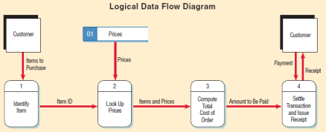
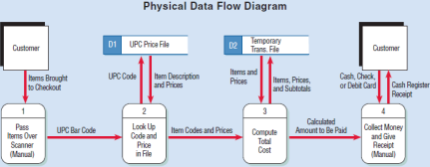

Slide 28
Logical Modeling
A logic model is a graphic depiction (road map) that presents the shared relationships among the resources, activities, outputs, outcomes, and impact for your program.
It depicts the relationship between your program's activities and its intended effects.
DFD doesn’t show logic inside the process – what occurs within a process, how input data is converted into output data.
Logical Modeling involves representing internal structure and functionality of processes depicted on a DFD.
Processes must be clearly described before translating them into programming language.
Logic modeling can also be used to show when processes on a DFD occur.

Slide 29
A logic model has 4 components:
1. Needs: are about the problem and why it's important to address it. What issue are we trying to address?
2. Inputs: are the things that contribute to addressing the need (usually a combination of money, time, expertise and resources). What resources are we investing?
3. Activities: describe the things that the inputs allow to happen. What are we doing with these resources?
4. Outcomes: are usually expressed in terms of measures of success. What difference are we hoping to make?

Slide 30
Types:
a. Structured English
b. Decision Tables
c. Decision Trees

Slide 31
Structured English/Pseudo-code
is an informal way of programming description that does not require any strict programming language
Basically an algorithm that can’t be compiled or interpreted by the computer.
Used for creating an outline or rough draft/documentation of a program
Is created by the merging of the English language with the syntax of the structured programming.
It tries to express the verbal statement in the more logical form
Improves readability of any approach
summarizes a program's flow, but excludes underlying details.

Slide 32
Common keywords used in Structured English
START, BEGIN, END, STOP, DO, WHILE, DO WHILE, FOR, UNTIL, DO UNTIL, REPEAT, END WHILE, END UNTIL, END REPEAT, IF, IF THEN, ELSE, IF ELSE, END IF, THEN, ELSE THEN, ELSE IF, SO, CASE, EQUAL, NOT, TRUE, FALSE, AND, OR, XOR, GET, WRITE, PUT, UPDATE, CLOSE, OPEN, CREATE, DELETE, EXIT, FILE, READ

Slide 33
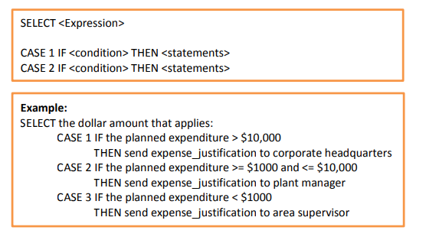
It uses three basic types of statements:
Sequence Structures: They include a set of instructions that are carried out one after another and do not depend on any condition.

Slide 34
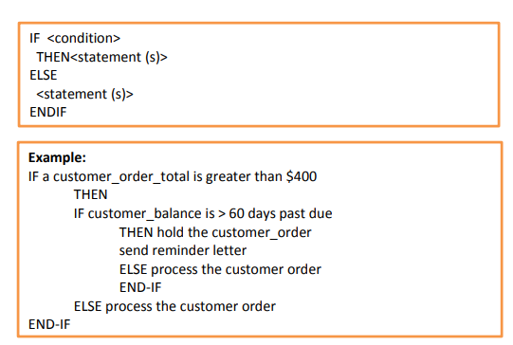
2. Decision Structures: They include one or more sets of instructions that are carried out depending upon one or more conditions. They generally use the phrase IF THEN ELSE to carry out different actions

Slide 35
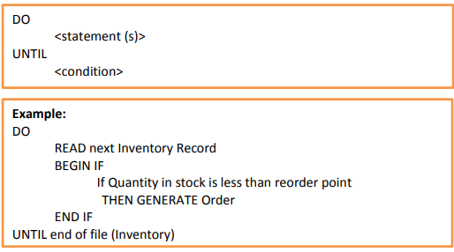
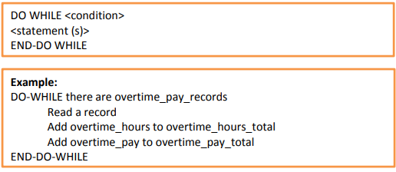
3. Iteration Structures: They include a set of instructions that are repeated until a particular condition occurs. They generally use the phrase DO WHILE ...ENDDO to repeat a set of instructions.

Slide 36
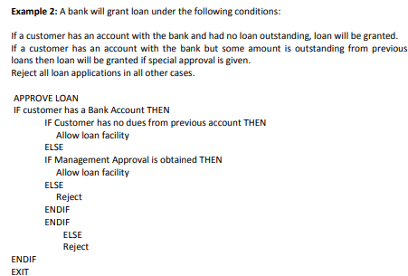

Slide 37
Decision Table
visual representation for specifying which actions to perform depending on given conditions.
i.e. identification of conditions and actions
They are algorithms whose output is a set of actions.
are used to model complicated logic.
is an excellent tool to use in both testing and requirements management.

Slide 38
Are tabular representation of decision points and corresponding actions
Condition | Condition Entries
Action | Action Entries

Slide 39
Eg, A customer requests a cash withdrawal.
ATM machine pays out the amount if the customer has sufficient funds in their account or if the customer has the credit granted or else rejected.
A decision table makes the same requirements clearer to understand:
Condition | R1 | R2 | R3
Withdrawal amount<=balance | T | F | F
Credit granted | - | T | F
Action
Withdrawal granted | X | X
Rejected |  |  | X

Slide 40
In a decision table, conditions are usually expressed as true (T) or false (F), Yes(Y) or No(N).
can be used in all situations where the outcome depends on the combinations of different choices.

Slide 41
Steps to create decision tables
Step 1 - Analyze the requirement and create the first column
Requirement:
"Withdrawal is granted if requested amount is covered by the balance
or if the customer is granted credit to cover the withdrawal amount".
Express conditions and resulting actions in a list so that they are either TRUE or FALSE.
In this case there are two conditions, "withdrawal amount <= balance" and "credit granted".
There is two result, the withdrawal is granted and withdrawal is rejected.

Slide 42
Condition
Withdrawal amount<=balance
Credit granted
Action
Withdrawal granted
Rejected

Slide 43
Step 2: Add Columns
Calculate how many columns are needed in the table.
The number of columns depends on the number of conditions and the number of alternatives for each condition.
Mathematically, the number of columns is 2^conditions. In this case 2^2 = 4 columns.
If there are two conditions and each condition can be either true or false, you need 4 columns.
If there are three conditions there will be 8 columns and so on.

Slide 44
Number of columns that is needed:
Number of Conditions | Number of Columns
1 | 2
2 | 4
3 | 8
4 | 16
5 | 32

Slide 45
Now is the time to fill in the T (TRUE) and F (FALSE) for the conditions.
How do you do that? The simplest is to say that it should look like this:
Row 1: TF
Row 2: TTFF
Row 3: TTTTFFFF
Row ……..
For each row, there is twice as many T and F as the previous line.
Repeat the pattern above from left to right for the entire row.
In other words, for a table with 8 columns, the first row will read TFTFTFTF, the second row will read TTFFTTFF and the third row will read TTTTFFFF.

Slide 46
Condition
Withdrawal amount<=balance | T | F | T | F
Credit granted | T | T | F | F
Action
Withdrawal granted
Rejected

Slide 47
Step 3: Reduce the table
Mark insignificant values with "-".
If the requested amount is less than or equal to the account balance it does not matter if credit is granted.
In the next step, you can delete the columns that have become identical.

Slide 48
Condition
Withdrawal amount<=balance | T | F | T | F
Credit granted | - | T | - | F
Action
Withdrawal granted
Rejected

Slide 49
Finish by removing duplicate columns.
In this case, the first and third column are equal, therefore one of them is removed.
Also Check for invalid combinations.
Invalid combinations are those that cannot happen,
for example, that someone is both an infant and senior. Delete that combination.
In this example, there are no invalid combinations.

Slide 50
Condition
Withdrawal amount<=balance | T | F | F
Credit granted | - | T | F
Action
Withdrawal granted
Rejected

Slide 51
Step 4: Determine actions
Enter actions for each column in the table.
Name the columns (the rules). They may be named R1/Rule 1, R2/Rule 2 and so on.
Condition | R1 | R2 | R3
Withdrawal amount<=balance | T | F | F
Credit granted | - | T | F
Action
Withdrawal granted | X | X
Rejected |  |  | X

Slide 52
Step 5: Write test cases
Write test cases based on the table. At least one test case per column gives full all business rules.
Test case for R1: balance = 200, requested withdrawal 200. Expected result: withdrawal granted.
Test case for R2: balance 100, requested withdrawal = 200, credit granted. Expected result: withdrawal granted.
Test case for R3: balance = 100, requested withdrawal = 200, no credit. Expected Result: withdrawal denied.

Slide 53
Decision Tree
is a flowchart like tree structure where
each internal node denotes a test on an attribute,
each branch represents an outcome of the test, and
each leaf node holds a class label.
a root on the left hand side and branches representing each decision.
read from left to right and the actions to be undertaken are recorded down the right hand side of the diagram.
is the most powerful and popular tool for classification and prediction.
defines complex relationships by describing decisions and avoiding the problems in communication.

Slide 54
Leaf Node
Decision Node
Leaf Node
Root Node
Leaf Node
Leaf Node
Decision Node
Decision Node
Leaf Node

Slide 55
On credit
Bad credit record
Reject order
On cash
Good credit record
Accept order to discount
No. of transaction
Sell amount>100
30% discount
Sell amount>100
10% discount
Sell amount>100
No discount

Slide 56
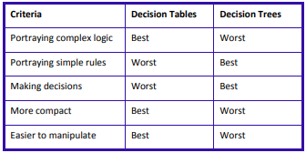
Differences between Decision Table and Decision Tree

